Slide 1
AI-driven Data Product
Dr. Junbum Kwon
WEEK1 ON July 27 2018

Slide 2
Lecturer: Dr. Junbum Kwon
School of Marketing, Marketing AI lab director
Marketing PhD in U of Toronto
Marketing Engineering, in-house consultant, LG
MS. Probability and Applied statistics lab at POSTECH I.E.
B. Industrial and Information System Engineering
Junbum.kwon@unsw.edu.au

Slide 3
TA
Daniel Han-Chen
Project Manager & AI Data Scientist at UNSW Marketing AI lab
DataSoc AI Lab Director
Head TA for Product/Advertising Analytics
UNSW B. Data Science and Decisions
daniel.han-chen@student.unsw.edu.au
James Lin
Data & AI Engineer at UNSW Marketing AI Lab
UNSW B. Computer Science, B. Mechatronics Eng.
james.lin1@unsw.edu.au

Slide 4
Big Data, Data Science, Artificial Intelligence
Video
https://www.youtube.com/watch?v=Dk7h22mRYHQ&t=1861s
https://www.youtube.com/watch?v=Y5KWcIRriT8

Slide 5
Scope
AI Application
Big Data Management
(Data Engineering)
Data Science

Slide 6
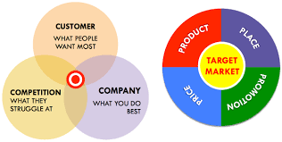
What does Marketing do?
3C Analysis → Targeting market → 4P Actions
(= Retail)
(and Advertising)

Slide 7
Application area of AI
41% in Technology (e.g. AI Data Product)
17% in MARKETING including Retailing
11% in General corporate setting
9% in Consulting
7% in Health care / Pharmaceuticals
6% in Financial services
4% in Government
2% in Gaming
(Source: 2018 SAS Campus tour)
Marketing managers and Marketing Analytics experts are collaborating to make actionable marketing decisions in terms of 4P, which is Product including technology, Price, Promotion including advertising, Place (i.e. Retail). Currently, Marketing-related industries has the highest demand for data scientists.

Slide 8
UNSW on Big Data, Data Analytics, and AI
Postgraduate Master Degree
Computer Science Engineering Information Technology Artificial Intelligence, Data Science & Engineering https://www.engineering.unsw.edu.au/computer-science-engineering/courses-programs/postgraduate-coursework/specialisations
Health Data Science https://cbdrh.med.unsw.edu.au/postgraduate-coursework
City Analytics https://www.be.unsw.edu.au/degrees/postgraduate-coursework/master-of-city-analytics
Business Analytics https://www.handbook.unsw.edu.au/postgraduate/plans/2018/INFSKS8404.html
Marketing Analytics
Bachelor Degree
Data Science and Decisions https://www.maths.unsw.edu.au/futurestudents/data-science-and-decisions
Actuarial Risk Management & Analytics http://www.handbook.unsw.edu.au/undergraduate/plans/2018/ACTLE13586.html

Slide 9
Marketing Analytics Core Courses:
MARK 5826 Product Analytics (2018 S2, 2019 Term 3)
https://www.business.unsw.edu.au/degrees-courses/course-outlines/archives/MARK5826-2018-S2
MARK 5827 Customer Analytics (2019 Term 2)
http://www.handbook.unsw.edu.au/postgraduate/courses/2018/MARK5827.html
MARK 5828 Advertising Analytics (2019 Term 1) - No prerequisite course
http://www.handbook.unsw.edu.au/postgraduate/courses/2018/MARK5828.html
MARK 5822 Marketing Analytics in a Big Data World (2019 Term 1)
https://www.business.unsw.edu.au/degrees-courses/course-outlines/MARK5822
MARK 5814 Digital Marketing (2019 Term 2)
https://www.handbook.unsw.edu.au/postgraduate/courses/2018/MARK5814.html

Slide 10
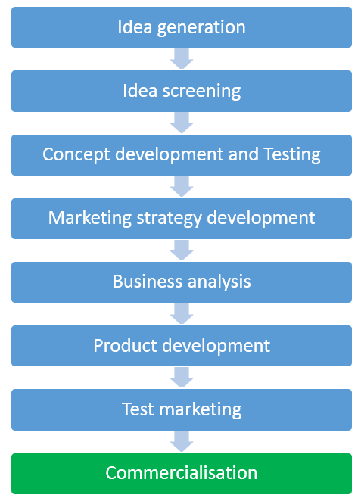
NPD (New Product Development) Process

Slide 11
Information Products
The expansion of the information economy that began in the mid-1990s
Significant increase in data resources due to
Enhanced hardware and software capabilities
Abundant broadband Internet access
Increasingly widespread use of the Internet.

Slide 12
Information Products
Electronic or printed products based on data, information, and knowledge
By Myer & Zack 1996
Internet ecommerce start-ups
Book, Music, Movie, …
The information economy began in the mid-1990s
Significant increase in data resources due to
Enhanced hardware and software capabilities
Abundant broadband Internet access
Increasingly widespread use of the Internet.

Slide 13
Information Product
NPD Process
Myer & Zack 1996
Data Acquisition
Refinement
Insight
Storage & Retrieval
Database
Distribution
CD-rom,
Web
Presentation
User-
interface

Slide 14
Big data, but not much insight?
CTO (Chief Technology Officer) big investment on database storage.
Data were rarely used in firm’s decision-making.
CFO (Chief Finance Officer) pushed CTO.
CTO and CMO work together.
Database supplier (e.g. Oracle, SAP) started to add data analytics in their software.

Slide 15
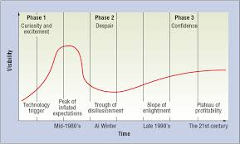
AI Winter

Slide 16
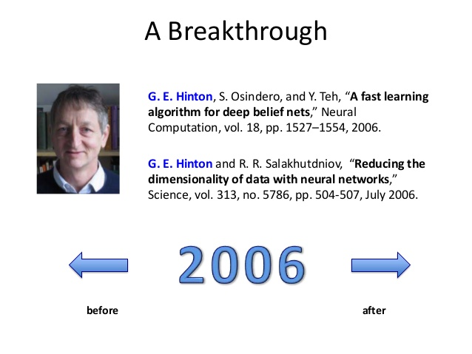
Prof. Geoffrey Hinton The Godfather of Deep Learning

Slide 17
Analytics-based Data Product
At first, data analytics for “Decision Support”
What if we increase price, profit increase or decrease?
Later, Analytics-based Data Product (or service)
Recommend books at Amazon and movies at Netflix
Linkedin “Jobs You may be interested”
Facebook “People You may know”
Mobile apps

Slide 18
Analytics-based Data Product
NPD Process
Davenport & Kudyba 2016
Conceptualizing the Product
Data Acquisition
Refinement
Storage & Retrieval
Distribution
Presentation
Market Feedback

Slide 19
Step1: Conceptualizing the Product
Consumer needs
Product idea generation
Product definition
Necessary data
Data product prototype

Slide 20
Step2: Data Acquisition
Company own data
Consumer behaviour data (e.g. search, purchase)
Public data
Type of data
Number, text, picture, videos

Slide 21
Step3: Refinement
Data exploration
Correlation pattern
Data visualization
Data analytics

Slide 22
Step4: Storage and Retrieval
Big data management
Efficient search

Slide 23
Step5: Distribution
Web
Mobile
Cloud
Dropbox
Amazon web service

Slide 24
Step5: Distribution
Web
Mobile
Cloud
Dropbox
Amazon web service

Slide 25
Step6: Presentation
Easier user interface
Real-time calculation using advanced data analytics

Slide 26
Step7: Market feedback
New available data
Consumer feedback
Social media
Product review website

Slide 27
Terminology: AI-driven data product
Big data analytics
Machine learning
Natural language processing
Computer vision, image processing
AI seems to be representative word, recently.

Slide 28
Class Plan

Slide 29
Week | Lecture |  | Tutorial / Lab | Assessment
1 | Data Product using Artificial Intelligence |  | Python Function / Library | Lab Quiz
2 | Marketing New Product Ideas in Crowdfunding Platforms |  | Start-up Trend Analysis | Lab Quiz
3 | Data Product Development | (1) Recommendation | Collaborative Filtering & Preference Matching | Lab Quiz
4 |  | (2) Content Products | Content Optimization | Lab Quiz Assignment
5 |  | (3) Internet of Things | IoT | Lab Quiz
6 |  | (4) Virtual Personal Assistants | Presentation | Interim Presentation
7 | Product Idea Generation From | (1) Social Media | Topic Model Feedback on Projects | Lab Quiz Assignment
8 |  | (2) Product Reviews | Presentation | Final Presentation (Group Project)
9 | Product Attribute Optimization |  | Conjoint Analysis & Variable Selection | Lab Quiz
10 | New Product Demand |  | Presentation | Final presentation (Individual Research)

Slide 30
Week | Month | Date (Fri) | PASS (1) | Lecture | Tutorial/Lab
1 | 7 | 27 | NA | 5:30~7:00 | 7:00~9:00
2 | 8 | 3 | NA | 5:30~7:00 | 7:00~9:00
3 | 8 | 10 | 4:30 - 5:30 | 5:30~7:00 | 7:00~9:00
4 | 8 | 17 | 4:30 - 5:30 | 5:30~7:00 | 7:00~9:00
5 | 8 | 24 | 4:30 - 5:30 | 5:30~7:00 | 7:00~9:00
6 | 8 | 31 | 4:30 - 5:30 | 5:30~7:00 | 7:00~9:00
7 | 9 | 7 | 4:30 - 5:30 | 5:30~7:00 | 7:00~9:00
8 | 9 | 14 | 4:30 - 5:30 | No class | No class
9 | 9 | 21 | 4:30 - 5:30 | No class | No class
Study week | 9 | 28 | NA | NA | NA
10 | 10 | 5 | 4:00 - 5:00 | 5:00~6:30 | 6:30~9:00
11 | 10 | 12 | 4:30 - 5:30 | 5:30~7:00 | 7:00~9:00
12 | 10 | 19 | 4:00 - 5:00 | 5:00~6:30 | 6:30~9:00
PASS (2) – Tuesday 2 ~ 3 pm from week 3

Slide 31
Lecture, Tutorial, lab format
Combined Lecture/Tutorial/Lab work
Conceptual framework
Data analytics using Python
Exercising lab quiz

Slide 32
Assessment
Assessment Task | Weighting | Length | Due Date
Lab quizzes | 20 | During lab | Week 1,2,3,4,5,7,11
Assignment | 20 | 3~4 questions | Week 4, 9 (Sat 10 pm)
Group term project | 30 | Interim presentation Interim report (1 pages) Final presentation Final report (5 pages) | Week 6 Week 6 (Sat 10 pm) Week 10 Week 10 (Sat 10 pm)
Individual research | 30 | Interim report (1 page) Final presentation (3 minutes) Final report (5 pages) | Week 7 (Wed 10 pm) Week 12 Week 12 (Sat 10 pm)

Slide 33
Assessment
Lab work – quiz
Goal is to make sure what to learn, rather than evaluate students critically
Assignment
More problem questions

Slide 34
Assessment
Group project
Data analytics work
New AI-driven data product
We will provide many examples
Candidate problems
Data source
Consultation

Slide 35
Assessment
Individual research project
Making research hypothesis]
E.g. African American femle founder has disavantage in Kickstarter crowdfunding. Is it good for them to come to their own Video advertising in Kickstarter?

Slide 36
Communication
Kaggle.com: sharing lecture python code
If you set up Python in your laptop, please use Python 3.6 or above.
We experiment to move from Moodle to Microsoft team. More details on next Friday.
Microsoft team:
Software https://docs.microsoft.com/en-us/microsoftteams/get-clients
Class Q&A: Everyone MARK5826 Semester 2 2018
Each group will make Microsoft team for communication.

Slide 37
Communication
Consultation time:
For technical problems, see TA: Wed 2~3 pm & Thursday 1:30 ~ 2:30 pm at Quad 3003
Lecturer: Tuesday 1:30 ~ 2:30 pm at Quad 3031B
PASS (Peer Assisted Study Sessions) from week 3 by Daniel Han-Chen: Tuesday 2~3 pm at Quad G054, Friday 4:30~5:30 at Quad 1043
Mark5826@unsw.edu.au (Until approved)
Lecturer: Junbum.kwon@unsw.edu.au
TAs: daniel.han-chen@student.unsw.edu.au & james.lin1@unsw.edu.au

Slide 38
Other New Product Courses
MARK5813 New Product and Service Development
How innovation occurs and why some innovations rise to dominate others.
Evaluate NPD projects and develop collaboration and protection strategies.
MARK6102 Creativity, Innovation and Change in Marketing
Creative product idea generation
GSOE9445 Entrepreneurial Engineering
Entrepreneurial process
MCIC founder’s program http://mcic.unsw.edu.au/founders-program

Slide 39
Other Marketing Analytics Course: MARK 5828 Advertising Analytics

Slide 40
Other Marketing Analytics Course: MARK 5828 Advertising Analytics (2019 Term 1) - No prerequisite course
Week | Lecture
1 | Trend of Ad Technology & Ad Content Analytics
2 | Analytics Platform for Analysing Ad Content - Amazon Web Service (AWS) API - Google/Microsoft API
3 | Ad Content | (1) Text Analytics - Keyword Ad - Google AdWords
4 |  | (2) Speech Analytics: Sound, Tone - Radio Ad, Video Ad
5 |  | (3) Picture Analytics: Objects, Colour - Social Media Ad
6 |  | (4) Video Analytics: Moving Objects - YouTube Ad, Video Ad for Crowdfunding
7 |  | (5) Ad Content Optimization - Text + Speech + Picture + Action
8 | New Ad Technology To | (1) Access Target Customers - Facebook's Target Ad - Outdoor Ad in Hot-spot Location - Automatic Programmatic Ad - Ethics: Targeting Power vs Privacy
9 |  | (2) Measure Ad Effect - Consumer Search - Eye-tracking / Face Emotion
10 |  | (3) Improve Ad Content - 3D - Virtual & Augmented Reality

Slide 41
Other Marketing Analytics Course: MARK 5827 Customer Analytics (2019 Term 2)
Week | Lecture
1 | Customer Relationship Management (CRM) & Big Data Analytics
2 | Attract New Consumers | (1) Ad Targeting on YouTube, Search-based Retargeting
3 |  | (2) Virtual Sales Agents (Chatbot)
4 | Retaine Customers | (1) Mobile Coupons based on Purchase History
5 |  | (2) Churn Analysis
6 | Recommend Own Products | Up-selling Cross-selling
7 | Manage Multichannel Customers | Omni-channel Marketing
8 | Deal with Customer Complaints | Complaint Management in Social Media & Call Centre
9 | Encourage Referrals | Word-of-mouth
10 | Reinvite Silent or Lost Customers

Slide 42
Other Marketing Analytics Course: MARK 5828 Advertising Analytics
MARK 5826 Product Analytics (2018 S2, 2019 Term 3)
https://www.business.unsw.edu.au/degrees-courses/course-outlines/archives/MARK5826-2018-S2
MARK 5827 Customer Analytics (2019 Term 2)
http://www.handbook.unsw.edu.au/postgraduate/courses/2018/MARK5827.html
MARK 5828 Advertising Analytics (2019 Term 1) - No prerequisite course
http://www.handbook.unsw.edu.au/postgraduate/courses/2018/MARK5828.html
MARK 5822 Marketing Analytics in a Big Data World (2019 Term 1)
https://www.business.unsw.edu.au/degrees-courses/course-outlines/MARK5822
MARK 5814 Digital Marketing (2019 Term 2)
https://www.handbook.unsw.edu.au/postgraduate/courses/2018/MARK5814.html

Slide 43
Today
AI-driven data product process
Python function
Group building
Lab quiz

